Slide 1


Finding Funding Beyond Grants.gov:
Foundation Directory Online
Anita Ezzo
Grants Librarian
October 1, 2020

Slide 2
Foundation Directory Online Professional
Unsurpassed in:
Scope: 228K+ funders, ~1M recipients, 18.5M+ grants
Depth: Detailed profiles of funders, grants, recipients
Currency: Updated daily

Slide 3
Data Sources
Grantmaker websites
Annual reports
Published application guidelines
Direct reporting from grantmakers
Philanthropic press
Federal government grants
30+ other information sources

Slide 4
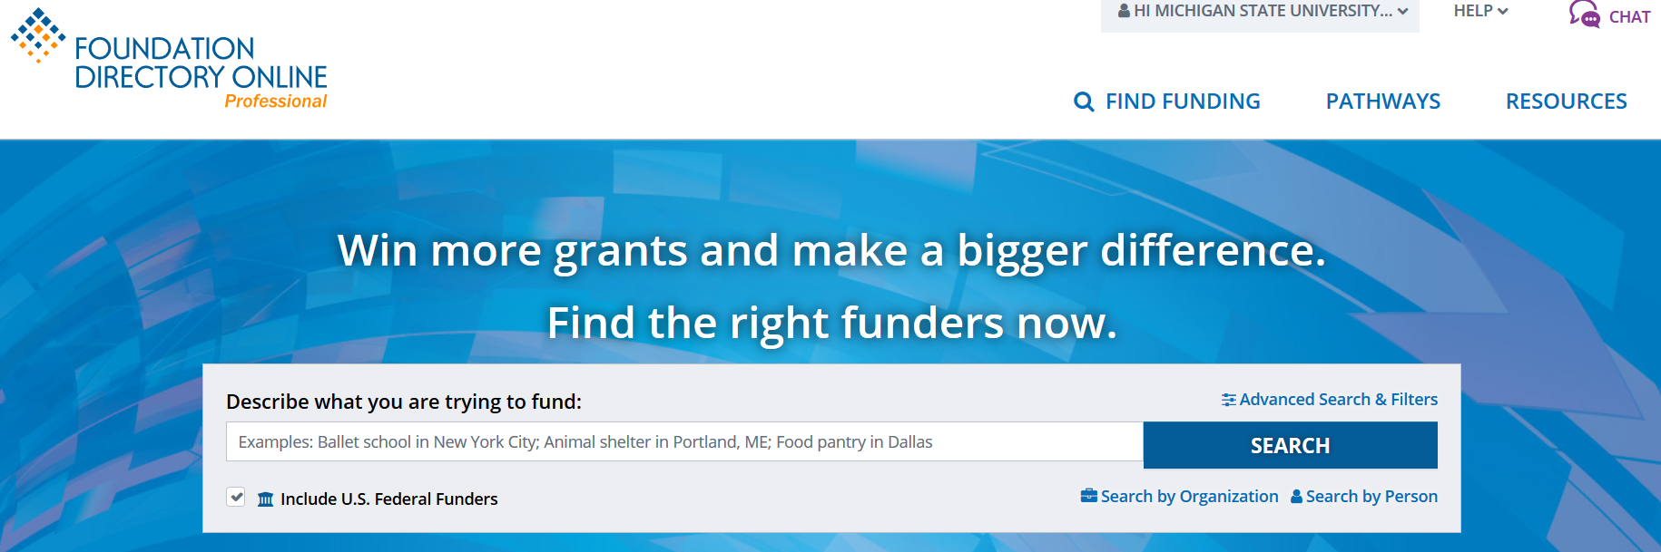
How to start search

Slide 5
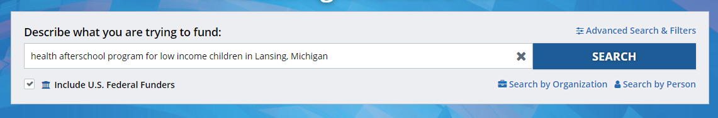
Search by Describing Who, What, Where

Slide 6
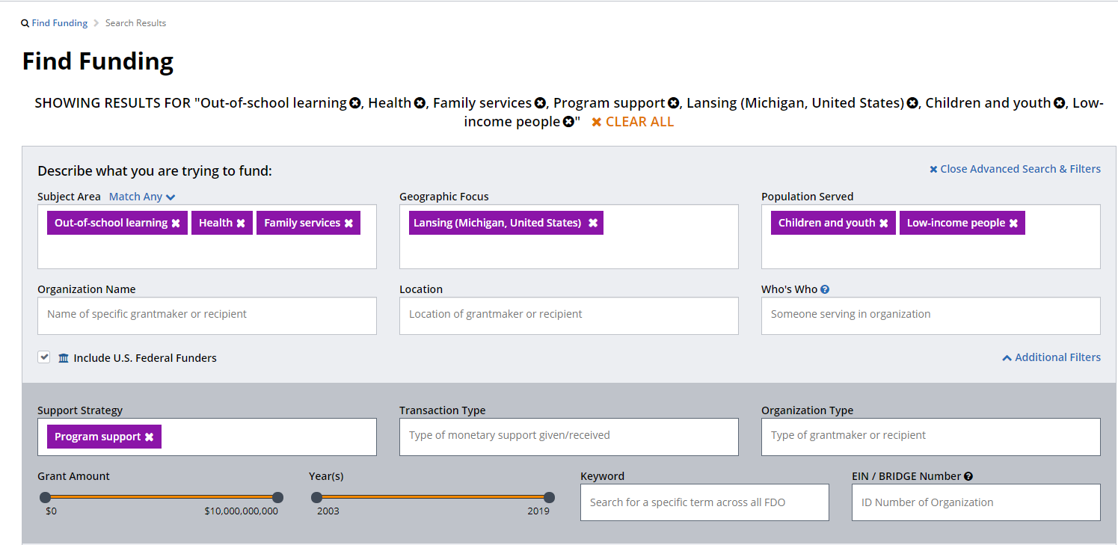
Search Filters

Slide 7
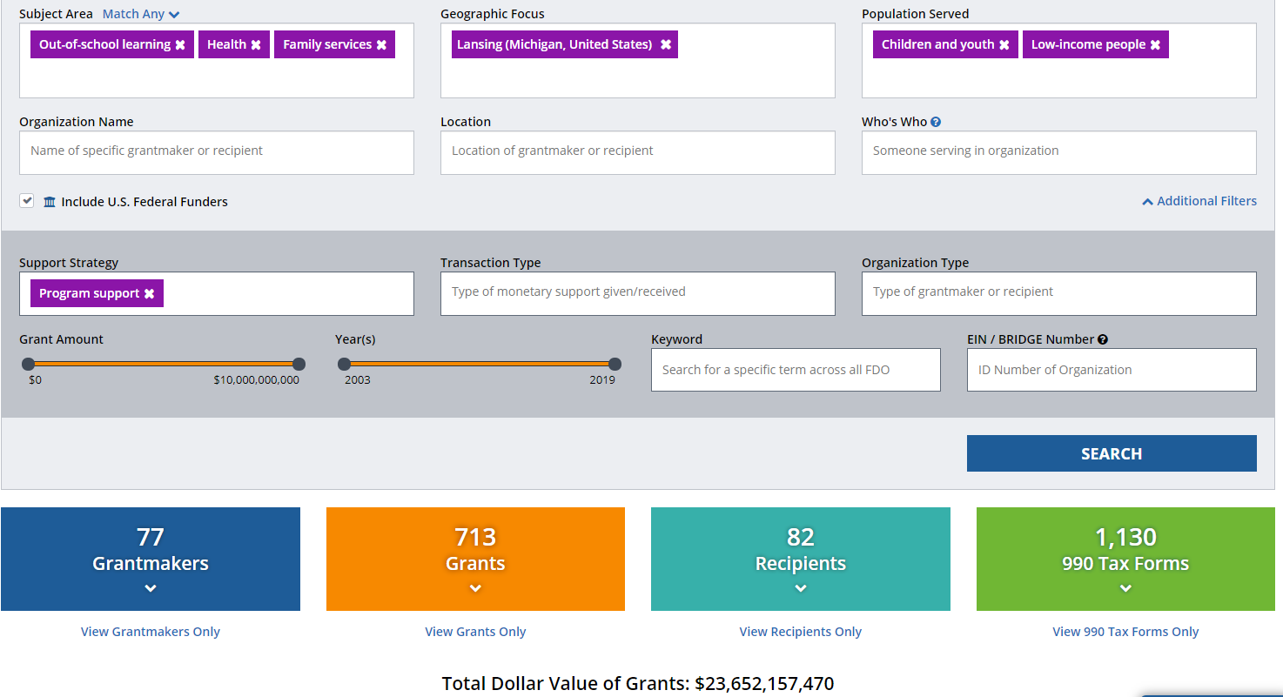
Search Results

Slide 8
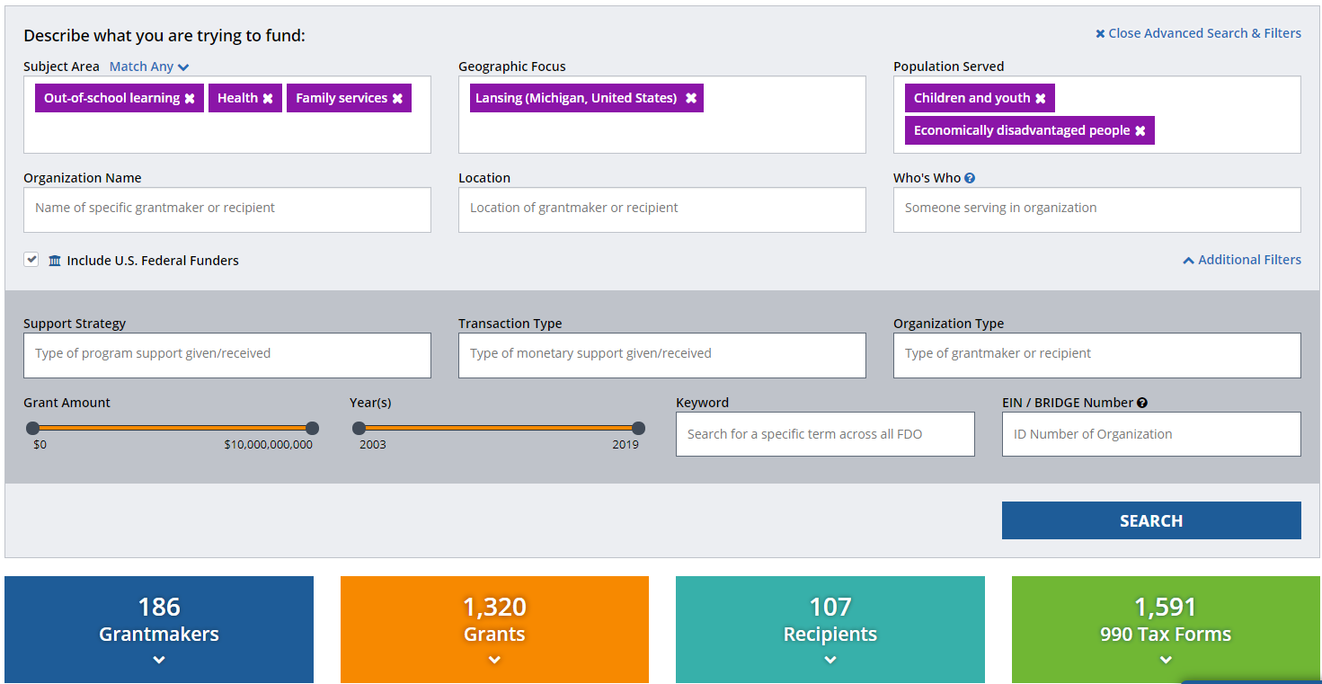
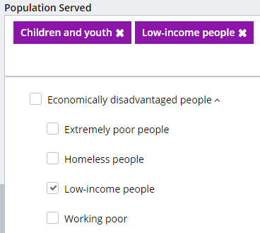
Broaden Search by Using Less-specific Terms

Slide 9
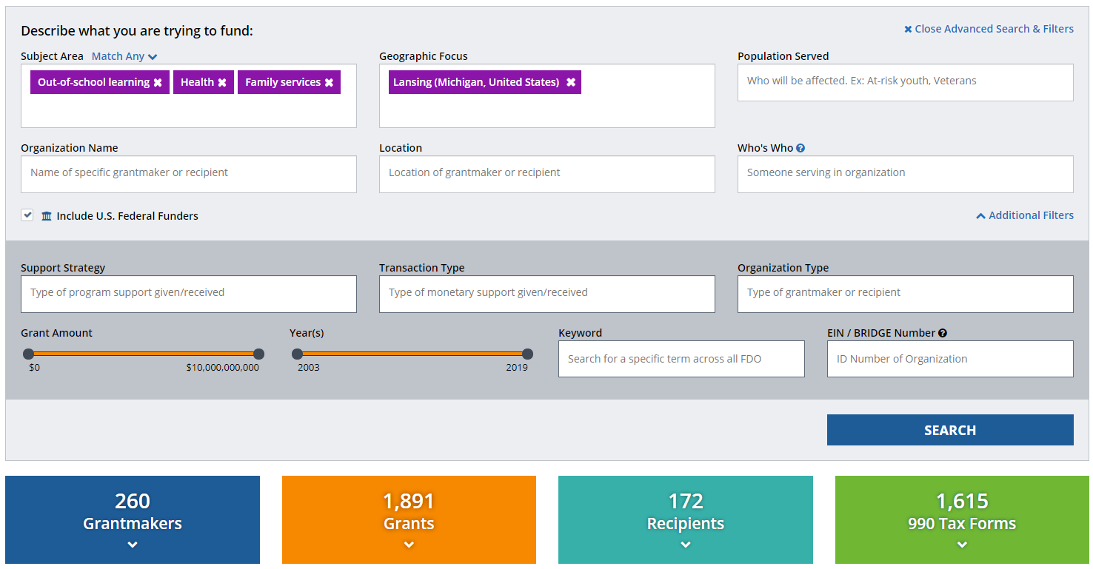
Broaden Search: Remove “Population Served” & “Support Strategy” Fields

Slide 10
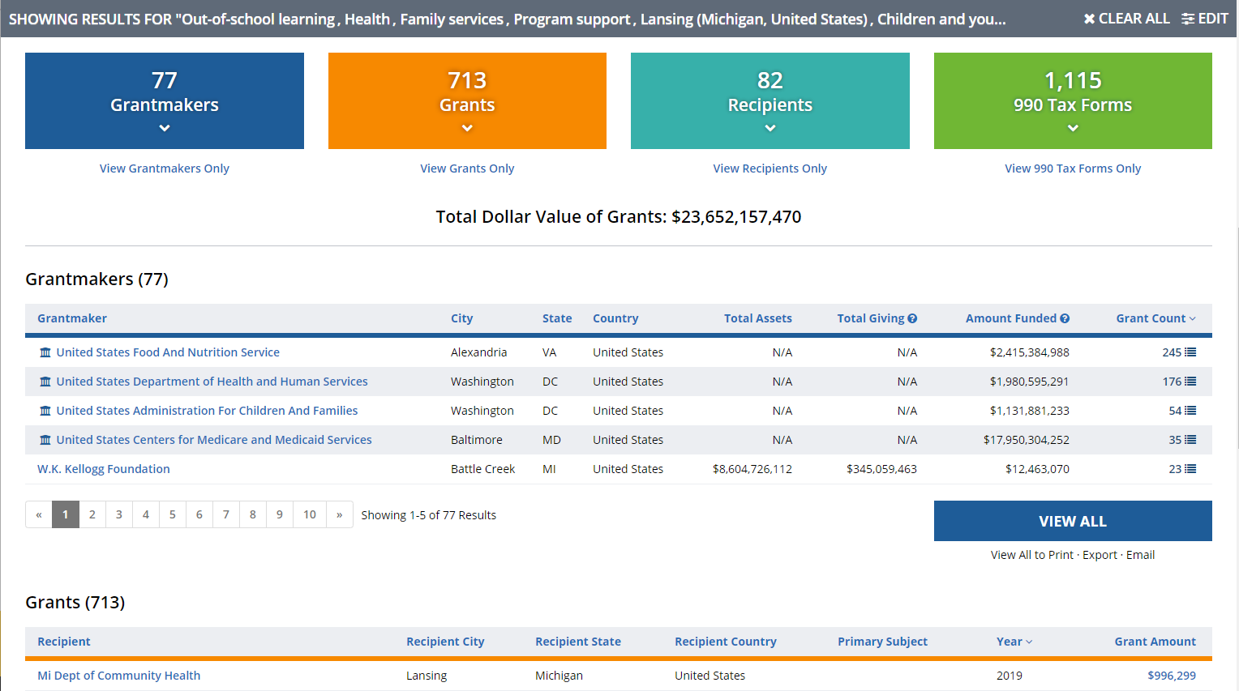
Grant Count

Slide 11
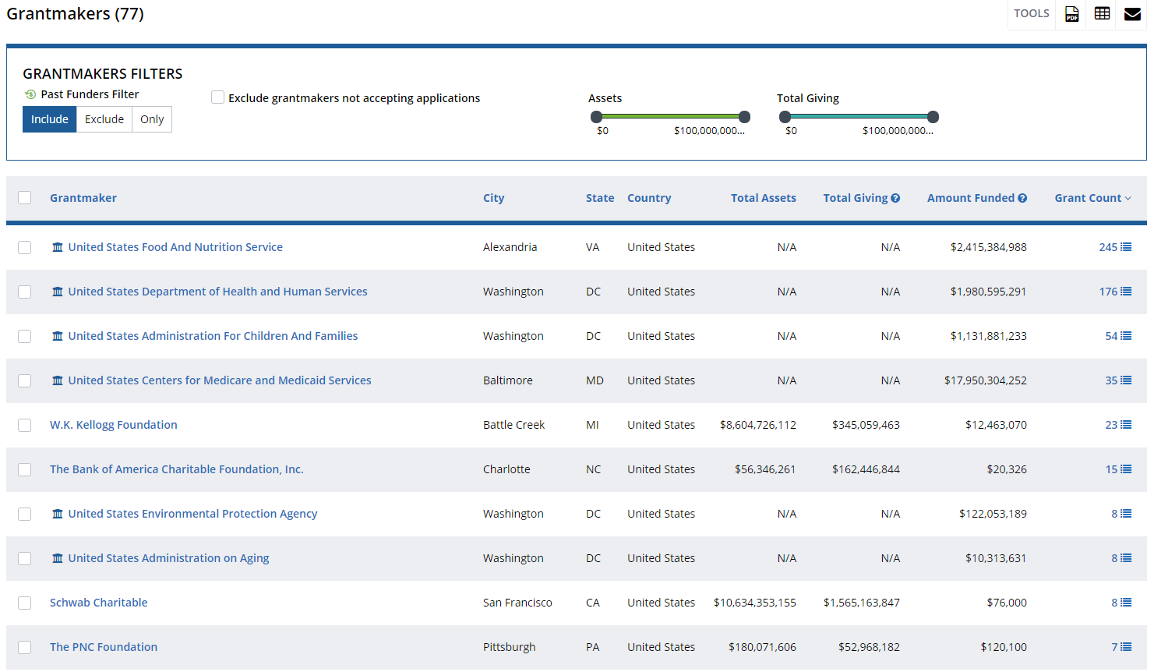
Foundation Example
Not recommended

Slide 12
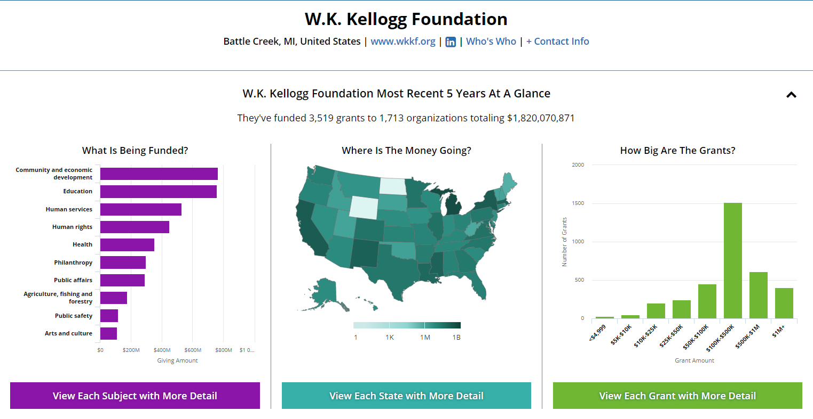
Foundation Cont

Slide 13
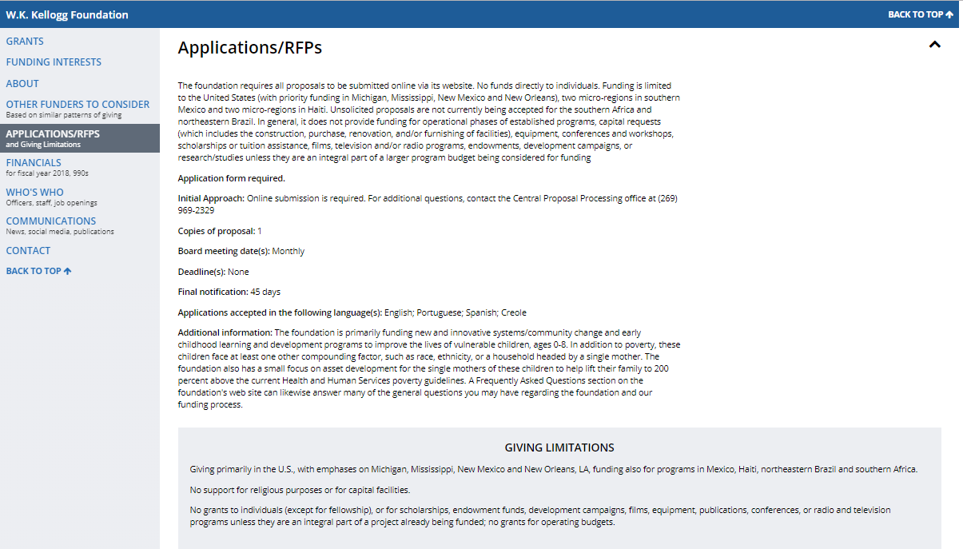
View Giving Limitations under Applications/RFPs

Slide 14
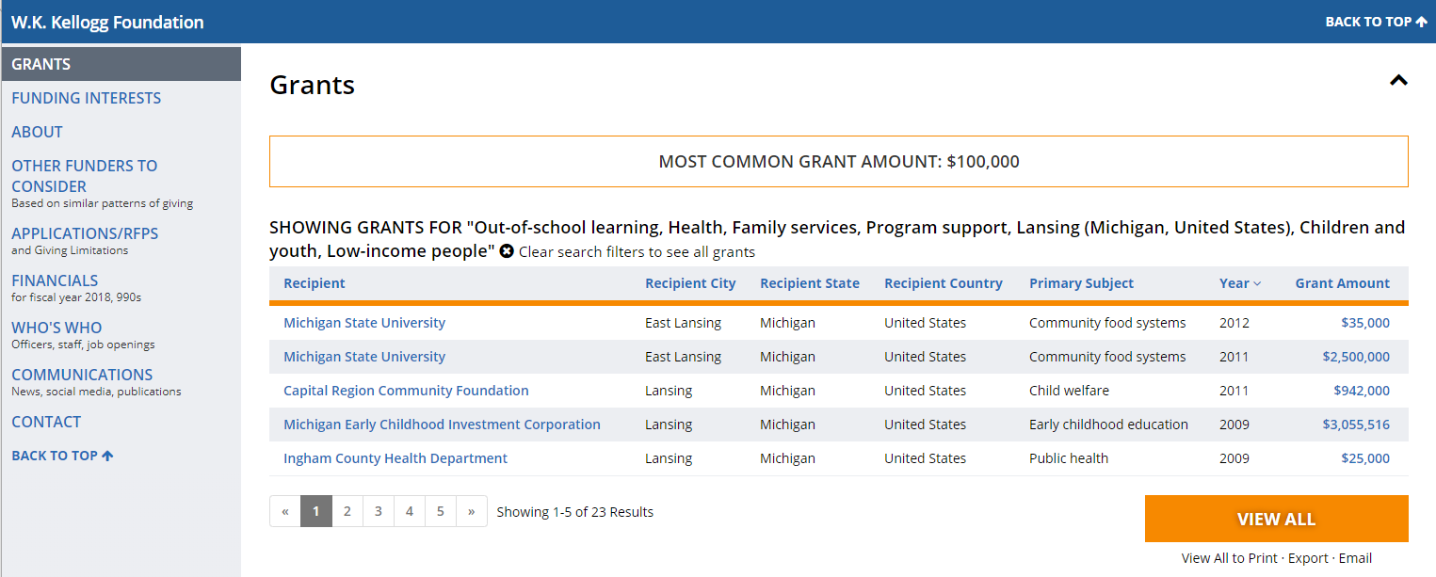
Common dollars

Slide 15
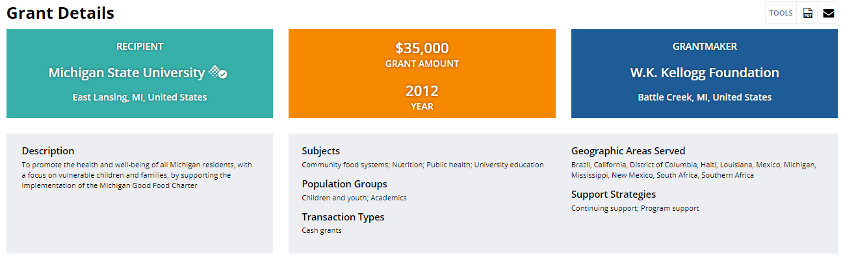
Grant Details

Slide 16
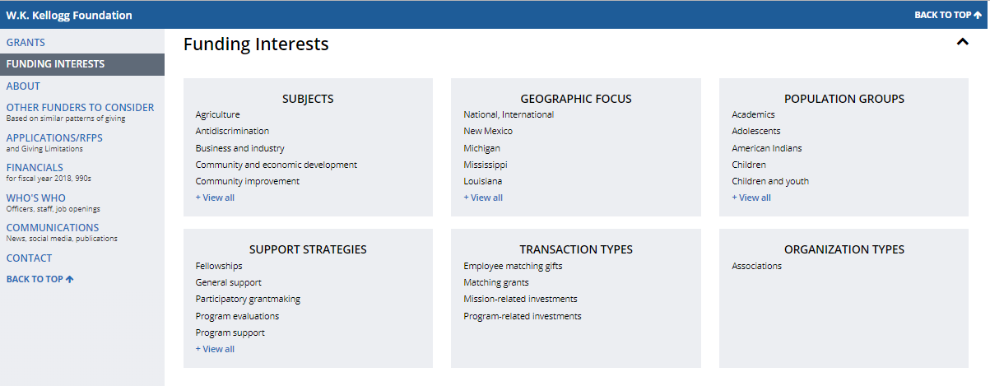
Funding Interests

Slide 17
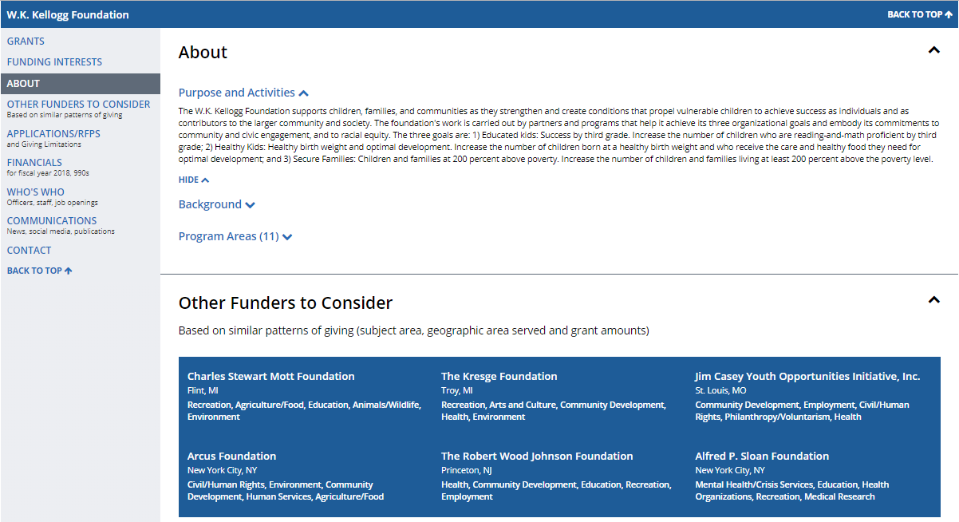
Foundation Details

Slide 18
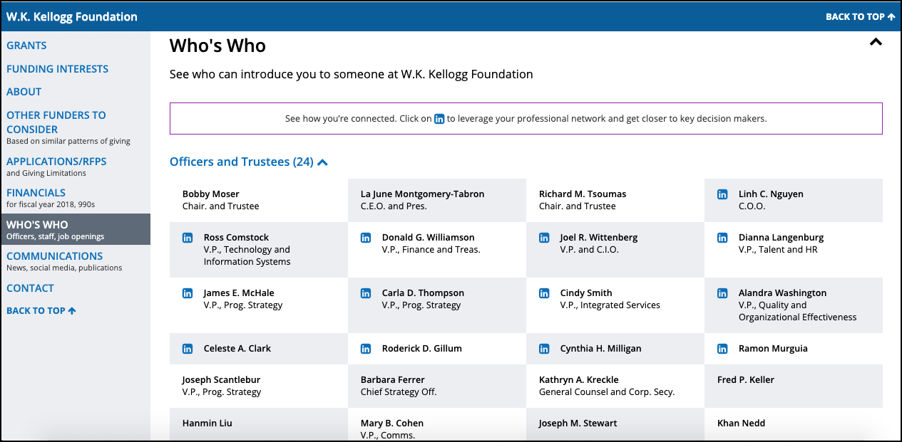
Who

Slide 19
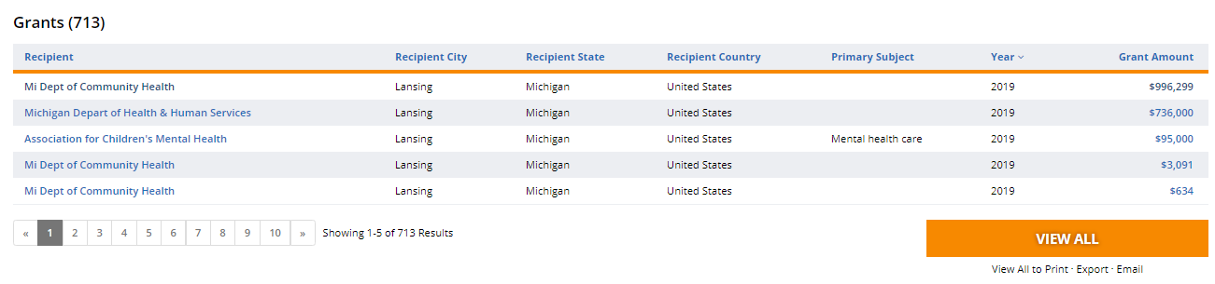
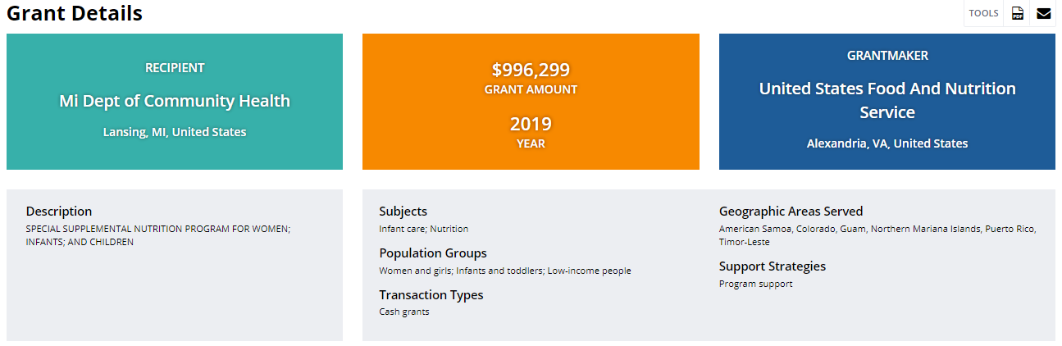
Recipients

Slide 20
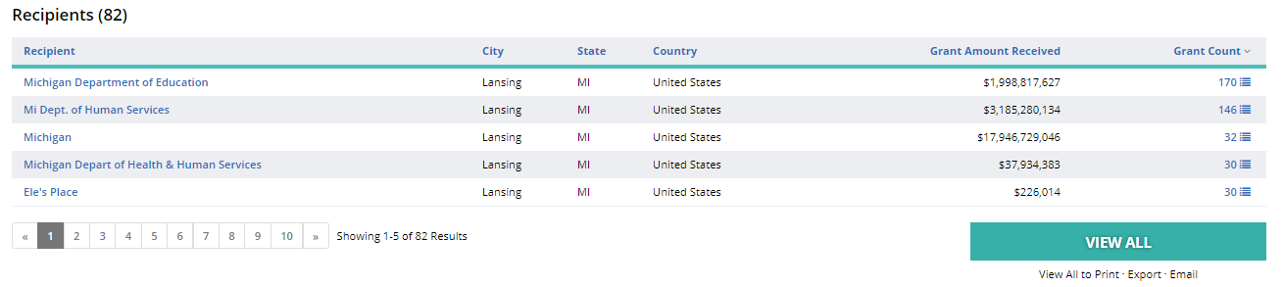
Grant Recipients

Slide 21
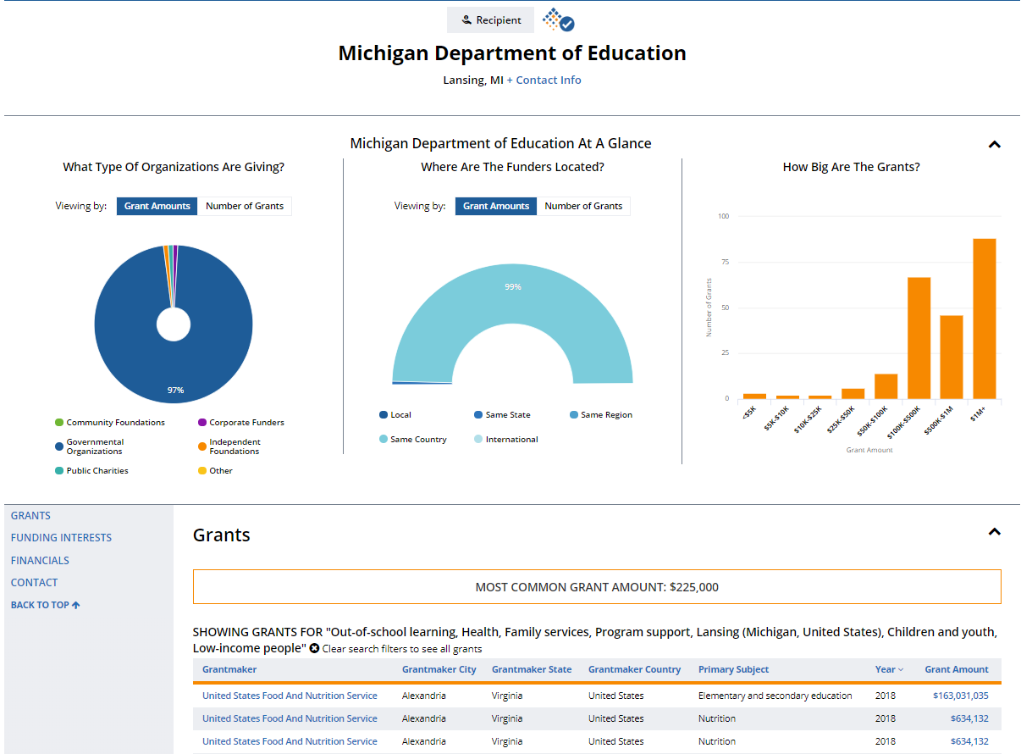
Recipient Profile

Slide 22
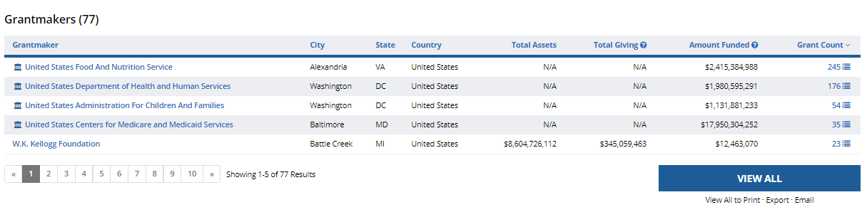

Save Your Results

Slide 23

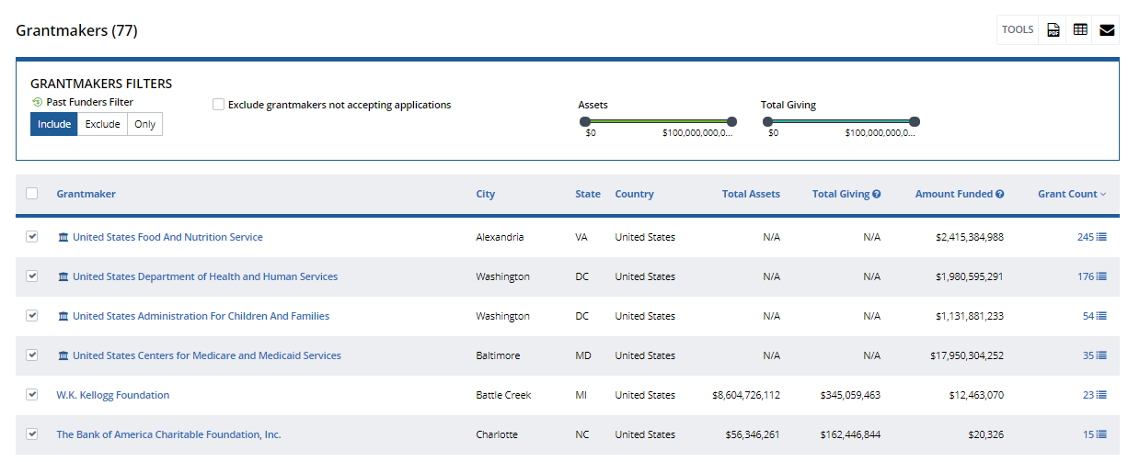
Grantmakers
Mark grantmakers of interest

Slide 24
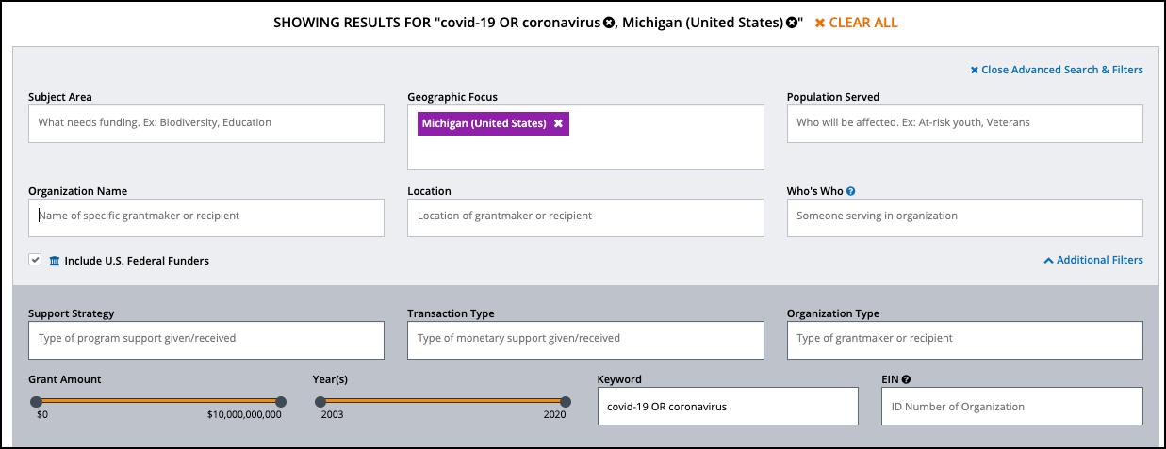
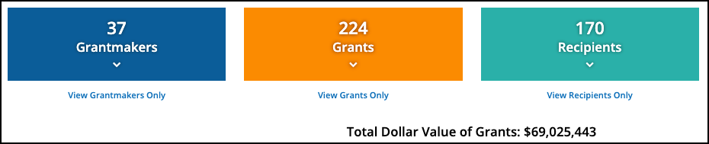
Results screen

Slide 25
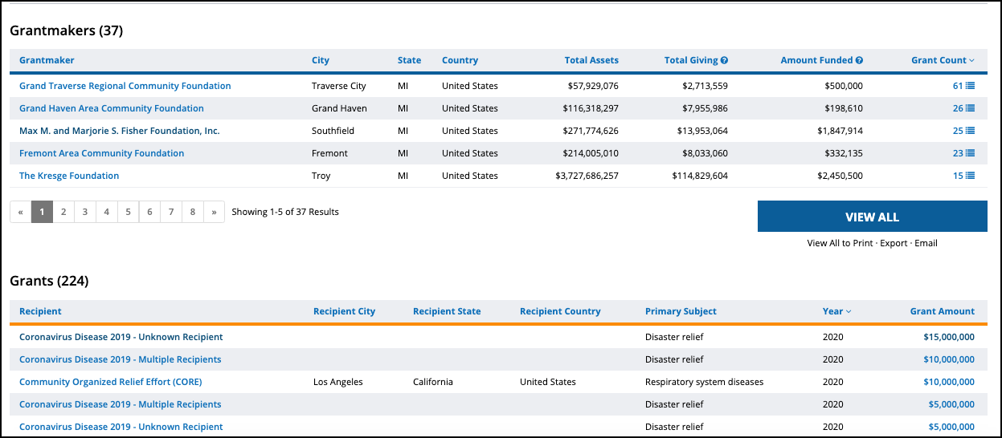
Grantmakers view

Slide 26
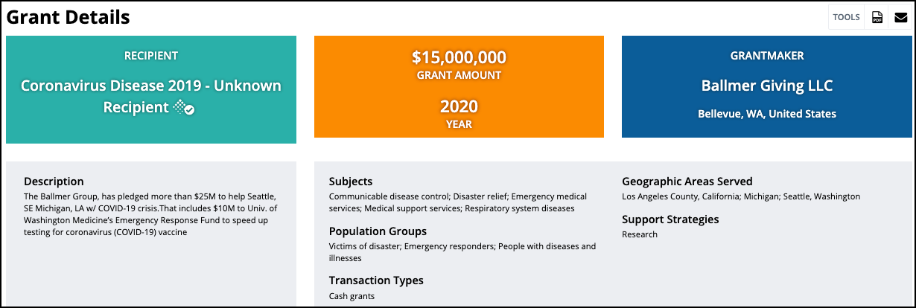
Population groups

Slide 27
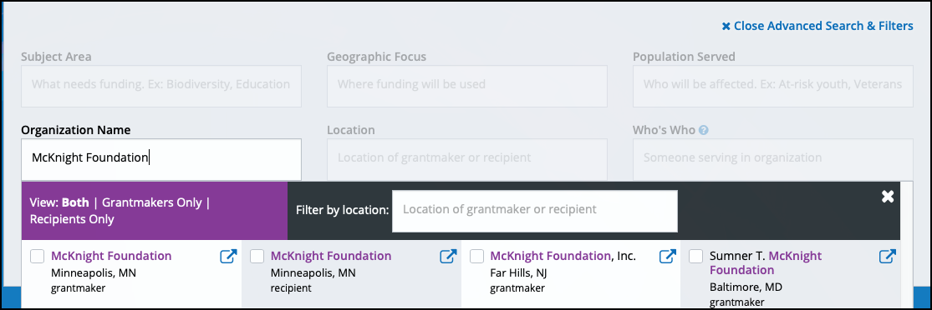

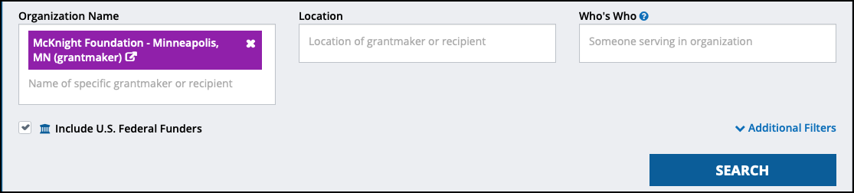
Foundation more

Slide 28
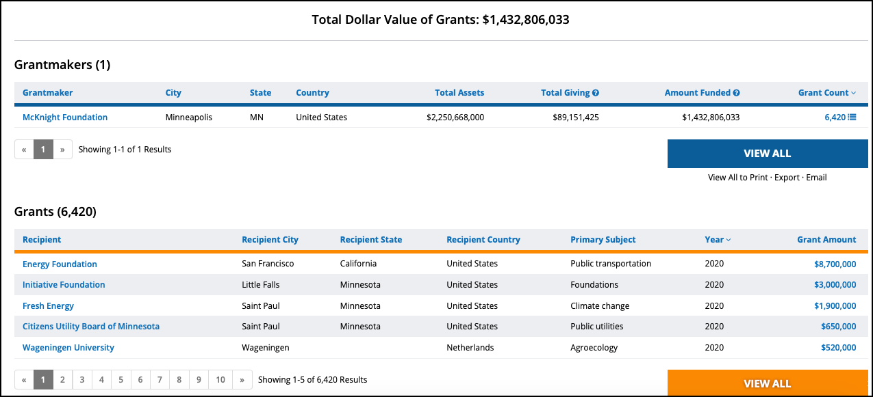
Total dollars

Slide 29
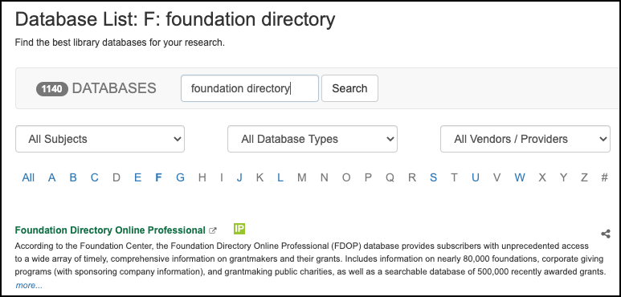
Access FDO via the Libraries’ A-Z Database List https://libguides.lib.msu.edu/az.php

Slide 30
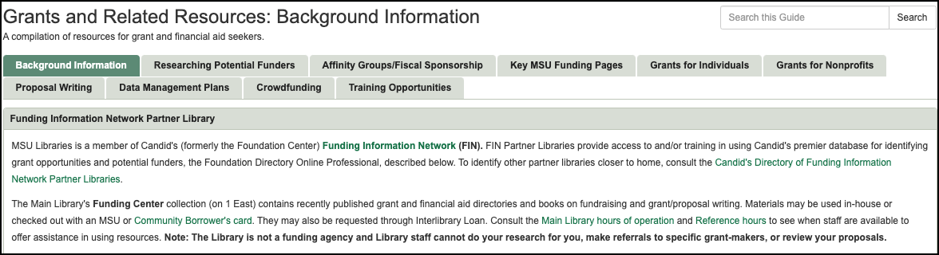
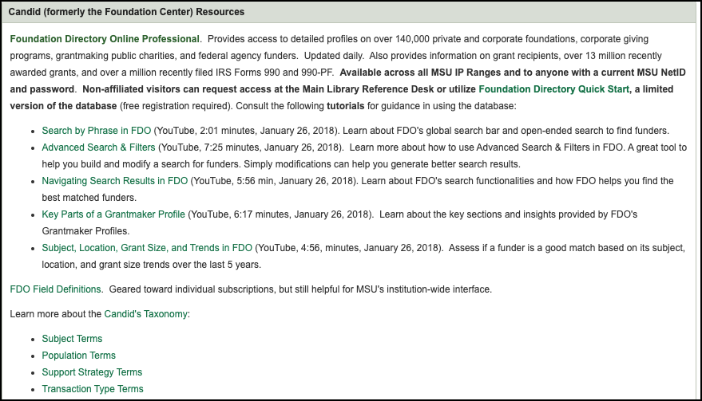
Via the Grants Research Guide https://libguides.lib.msu.edu/grants

Slide 31
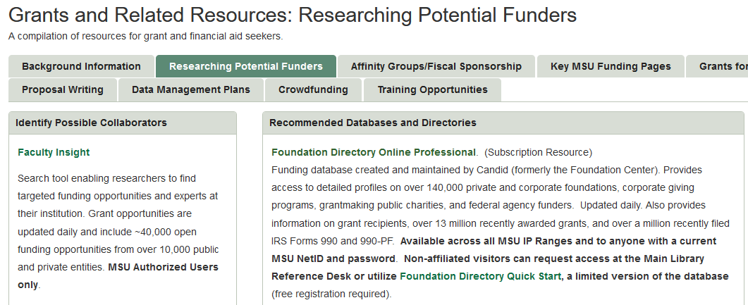
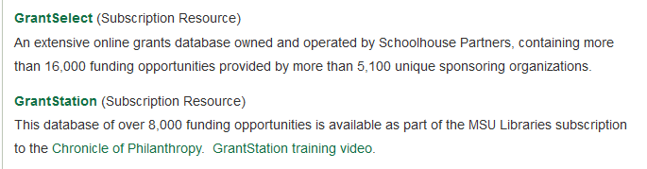
Potential Funders

Slide 32
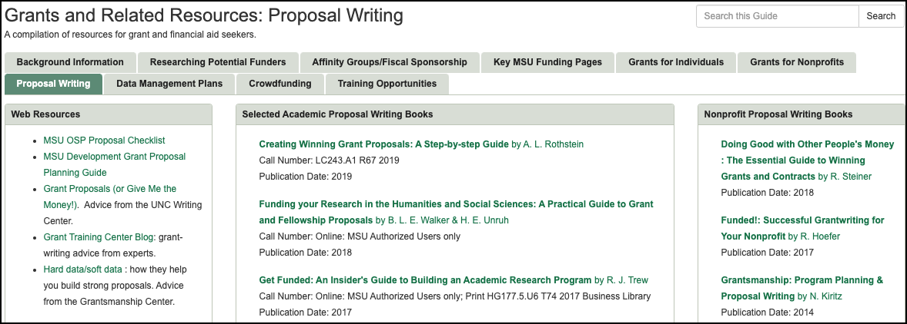
Proposal Writing Resources

Slide 33
Questions? Assistance?
Contact:
Anita Ezzo
Grants Librarian
ezzoa@msu.edu

