Slide 1

Welcome to New Faculty
Research Orientation
Presentations can be found online at
vp.research.msu.edu/NFRO
Ask questions in person, with notecards, or online at:
  PollEv.com/msu2019

Slide 2
World-Class University,
World-Class Scholarship
Welcome to Michigan State University Research
Stephen Hsu, Sr. Vice President for Research and Innovation
New Faculty Research Orientation
August 22, 2019
Notes:
2

Slide 3
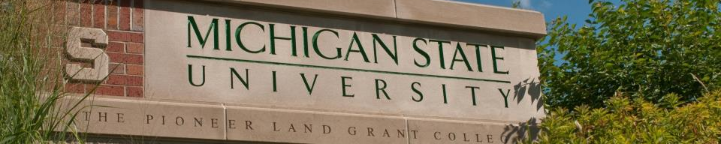
Research: Why We Do It
Dynamic research programs—based on a forward-thinking research agenda—address the problems of today and form the solutions of tomorrow
University research is often the basis of corporate R&D – economic benefits
Furthering research – advancing knowledge – gives MSU international prominence
Research is the basis for education and outreach and draws top students and faculty
Notes:
We are a member of an elite group - AAU
The most prestigious universities are research intensive
Story about Apple, how university research was the basis of many of the components
3

Slide 4
Faculty-Researcher Expectations
Faculty shape the reputation of MSU and are the drivers to expand research.
We strive to hire top faculty; each of us should strive to be more successful than those before us.
  Maintain a commitment to research excellence, integrity, and regulatory compliance.
  Publish cited research in top-tier journals.
  Pursue a larger share of federal research funds.
  Advance your career through conferences, boards, external collaborations and awards, etc.
  OSVPRI provides resources to help with all of this.
Notes:
Importance of encouraging faculty to remain research active
4

Slide 5
Research Expectations
Faculty who have established their individual research programs may advance their careers by pursuing large multi-investigator and interdisciplinary proposals.
Expand corporate research activity, develop intellectual property, and build successful spin-out companies
    MSU Business-CONNECT
    MSU Technologies
    MSU Spartan Innovations
MSU Innovation Center
Notes:
Importance of encouraging faculty to remain research active
5

Slide 6
Scholarship & Creative Activity
Competitive, university-wide, peer-reviewed internal grants programs support scholarly activities and provide seed funding for future proposals.
See https://vp.research.msu.edu/find-funding/msu-funding-opportunities
  Humanities and Arts Research Program (HARP)
  Strategic Partnership Grants
Visit https://vp.research.msu.edu/find-funding to see all funding resources
Notes:
Scholarship Development for research, creative, and performance projects that help faculty achieve career milestones; deadline in October.
Scholarship Completion, a subvention program for expenses associated with producing the results of a completed research or creative project; proposals accepted quarterly.
Scholarship Development for research, creative, and performance projects that help faculty achieve career milestones; deadline in October.
Scholarship Completion, a subvention program for expenses associated with producing the results of a completed research or creative project; proposals accepted quarterly.
for new projects, bridging grants, and seed funding needed for proposal resubmissions; proposals accepted quarterly.
6

Slide 7
What You Can Expect
Clearly stated performance expectations and evaluations from chair/director
Support of and guidance from research associate dean, department chair, senior faculty
Participation of OSVPRI in the promotion and tenure process
Strong mentoring programs, both internal and external to the department
Regulatory compliance support
Notes:
7

Slide 8

Proposal Development Assistance
Office of Research Facilitation and Dissemination (ORFD)
  Offers writing support on large, multi-author proposals. Call 432-4499 or https://vp.research.msu.edu/proposal-services
  Presents seminars and workshops, including monthly coffee break discussions. Check the events calendar for details https://vp.research.msu.edu/events
  OSVPRI additional offerings including:
  Special consulting and grant editing
  Peer review assistance
  Note: Your college or department may also offer proposal assistance.
Notes:
8

Slide 9
Remember:
We WANT you to be successful.
Today is about providing resources and contact information for you to refer back to.
Keep your folder; call or visit online when you need help.
https://vp.research.msu.edu/

Slide 10
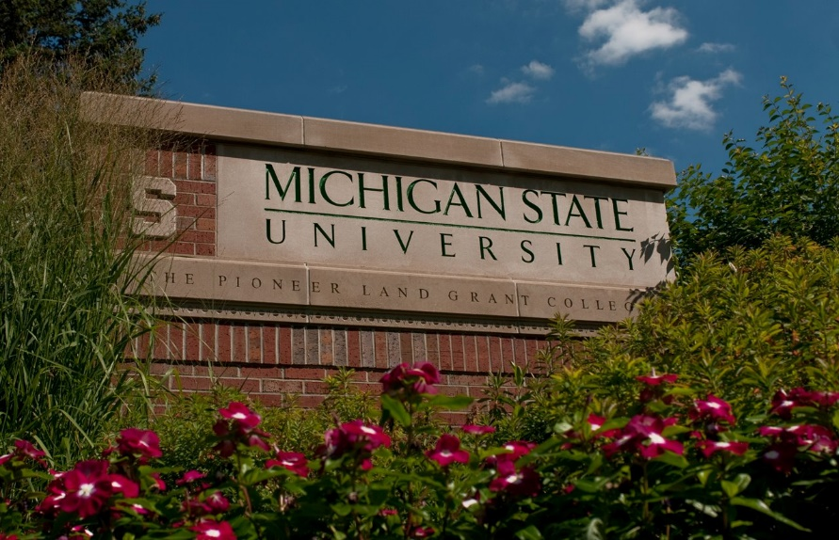
New Faculty Research Orientation
Research Policies and Compliance
Paul Hunt, Senior Associate Vice President for Research & Innovation
James Pivarnik, Research Integrity Officer

Slide 11
Export Control - Definition
A group of constantly changing laws and regulations that restrict ability to freely send or share certain goods, technology or information outside the U.S. or with non-U.S. nationals inside the U.S. – “deemed exports”.
These laws are intended to promote U.S. national security and other policy goals and they have broad extra-territorial reach.
ITAR controlled technology is restricted to U.S. citizens and permanent residents. EAR technology varies by specific citizenship.
Violations carry significant penalties and fines, including both University and individual liability.

Slide 12
Export Control – Fundamental Research
“Fundamental research” on a U.S. university campus is usually excluded from export controls under ITAR (military) and EAR (dual use) provisions. Open publication is key.
The “Fundamental Research Exclusion” is lost for:
  Encryption;
  If publication or citizenship restrictions apply;
  In-bound controlled data or equipment;
  For contracted prototypes or defense services.

Slide 13
Trade Sanctions
E.g., U.S. Treasury’s “Specially Designated Nationals” list and Trade Sanctions imply:
MSU USAID project participants must be careful with projects – e.g., in Afghanistan, Mali, and Sudan.
MSU Dubai – e.g., avoid Bank Melli (Iran gov’t link).
MSU Colleges of Music and Osteopathic Medicine, Libraries, and Alumni Association – participants must be careful during Cuba visits.

Slide 14
Foreign and Domestic Influence on Research
Federal agency requirements; fully acknowledging all external support.
MSU expectations including ongoing completeness of Conflict of Interest disclosures.
When in doubt please ask!
A webpage has been developed to help communicate these emerging guidelines at https://vp.research.msu.edu/foreign-influence-guidance

Slide 15
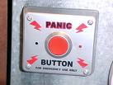


Issue Escalation
Remember: colleagues and students can be adversely affected if appropriate transparency is lacking.
We don’t have to fly solo.
Failure to escalate some issues can be a “career crash landing.”
    Health and safety concerns
    Criminality, discrimination, harassment
    Research or fiscal misconduct
    Regulatory compliance
When in doubt, ask – our staff can help. (517) 432-4499
Notes:
15

Slide 16
FBI – MSU Academic Alliance Conference
Thurs. September 5, 8 AM to 5 PM @ Kellogg Center Lincoln Room
Contact Export Control and Trade Sanctions at:
Phone: (517) 432-4499
Email: export@msu.edu
Website: http://exportcontrols.msu.edu
Address: 249 Administration Building

Slide 17
Regulatory Affairs - Who are we?
Human Research Protection Program
Animal Care Program
Environmental Health and Safety
Institutional Stem Cell Research Committee
Conflict of Interest
Responsible Conduct of Research (shared)

Slide 18
The Committees
Institutional Animal Care & Use Committee - Sue Barman, Chair
Sally Light, IACUC Administrator
Phone: 517-432-3154
E-mail: barman@msu.edu
Campus Animal Resources
Claire Hankenson, University Attending Veterinarian
Phone: 517-353-5064
E-mail: fclaire@msu.edu
Biological Safety Office – John Gerlach, Chair
Jamie Willard, Biological Safety Officer
Phone: 517-353-1877
E-mail: cherryme@msu.edu
Faculty Conflict of Interest Office
Brian Mattes, Director
Phone: 517-884-7000
Email: mattesbr@msu.edu
Radiation Safety Office – Chris Waters, Chair
Bryan Harris, Radiation Safety Officer
Phone: 517-884-3309
E-mail: harris@ehs.msu.edu
Human Research Protection Program (HRPP)
Kristen Burt, Director
Ashir Kumar, Chair BIRB - Harry McGee, Chair SIRB
Phone: 517-884-6020
E-mail: irb@.msu.edu
Chemical Safety Office – Christine DiFonzo, Chair
Genevieve Cottrell, Chemical Safety Officer
Phone: 517-432-8715
E-mail: cottre36@ehs.msu.edu
Stem Cell Oversight – Katheryn Meek, Chair
Kristen Burt , Director
Phone: 517-884-6020
E-mail: burtkris@msu.edu

Slide 19
What do we do?
Facilitate research
Protect the research subject and the investigator
Maintain compliance with state and federal laws, regulations and policies
Training
Accreditation

Slide 20
How can we help investigators?
Assist faculty in working through protocol approval process
Help stay in compliance through post-approval monitoring
Provide online and hands-on training
Work with your faculty to ensure a safe work environment

Slide 21
Questions
  www.ora.msu.edu
It is always best to directly contact the regulatory office with questions!

Slide 22
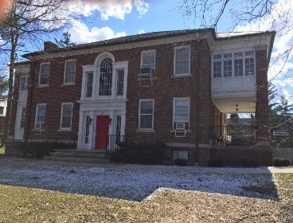
What Every MSU Community Member Should Know About Research Misconduct
James M. Pivarnik, PhD
Research Integrity Officer (RIO)
Michigan State University www.rio.msu.edu
RIO@msu.edu
106 Wills House
517-432-6698
Questions: PollEv.com/msu2019

Slide 23
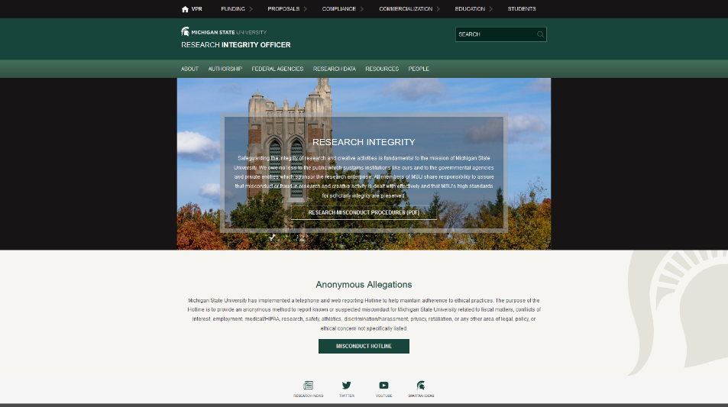
Our website URL
www.rio.msu.edu

Slide 24
What the RIO does
The RIO is responsible for seeing to it that the MSU Procedures Concerning Allegations of Misconduct in Research and Creative Activities are carried out in an unbiased, confidential, and professional manner.
Required for any institution seeking and accepting federal funding (42 CFR 93)

Slide 25
The role of the RIO
The RIO shall coordinate implementation of these Procedures and shall be responsible for their fair and impartial administration. The RIO shall not be an advocate for the Complainant or the Respondent.

Slide 26
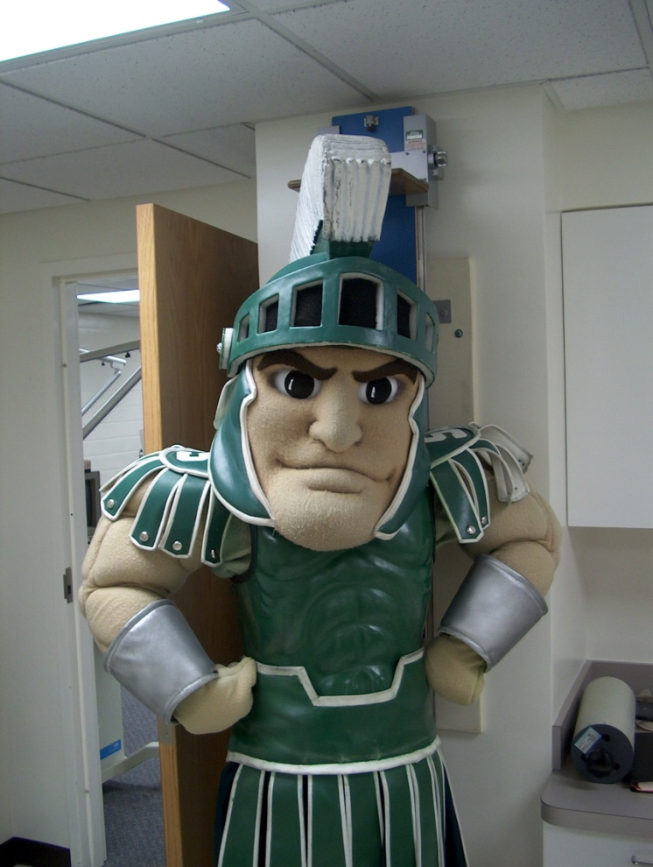
What exactly is
“Research Misconduct”?

Slide 27
Research Misconduct
Fabrication, Falsification, Plagiarism, or any other practice, that Seriously Deviates from practices commonly accepted in the discipline or in the academic and research communities generally in proposing, performing, reviewing, or reporting Research and Creative Activities.
Misconduct does not include appropriative practices in the Creative Arts insofar as they accord with accepted standards in the relevant discipline. Misconduct does not include honest error or honest differences in the interpretation or judgment of Research data.

Slide 28
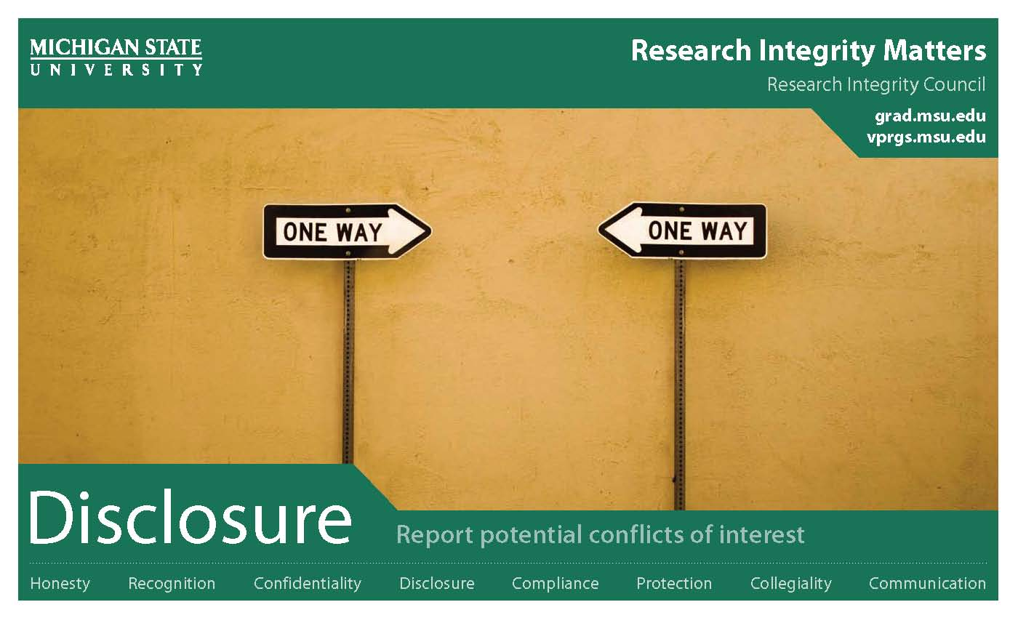
Disclosure: Report Potential Conflicts of Interest

Slide 29
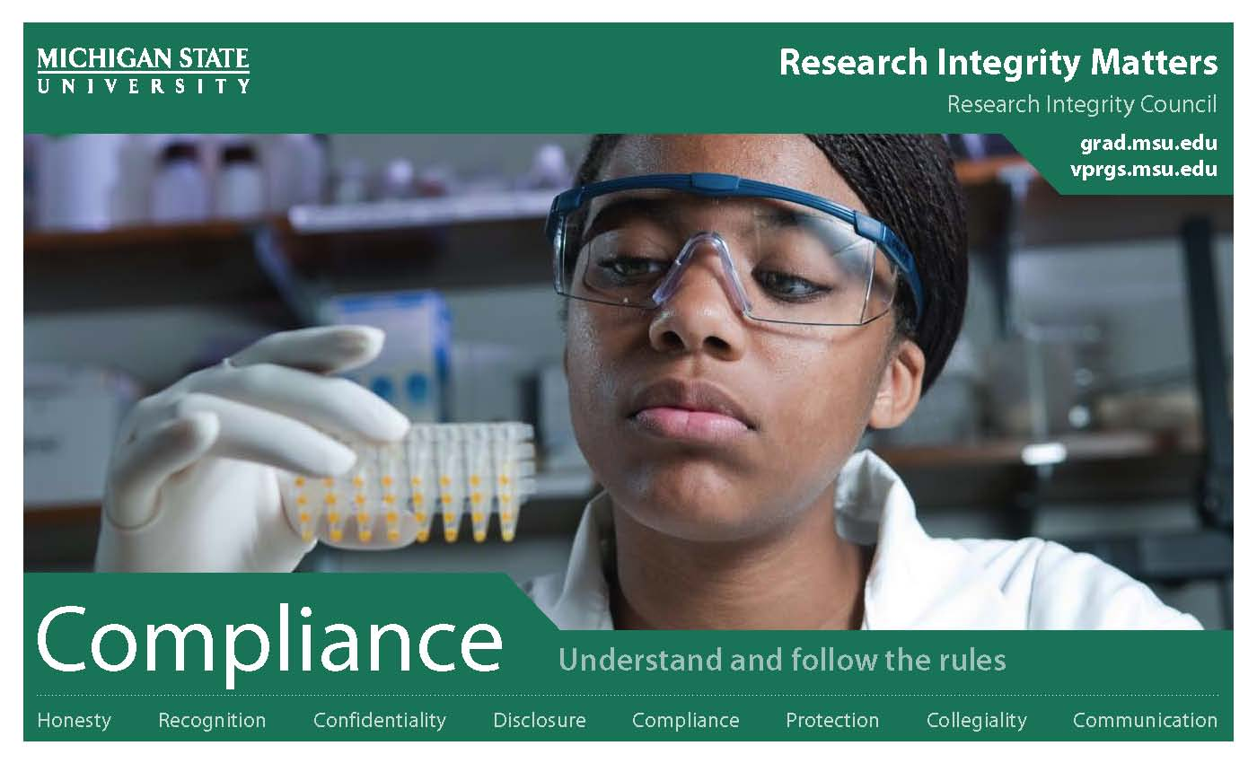
Compliance: Understand and follow the rules

Slide 30
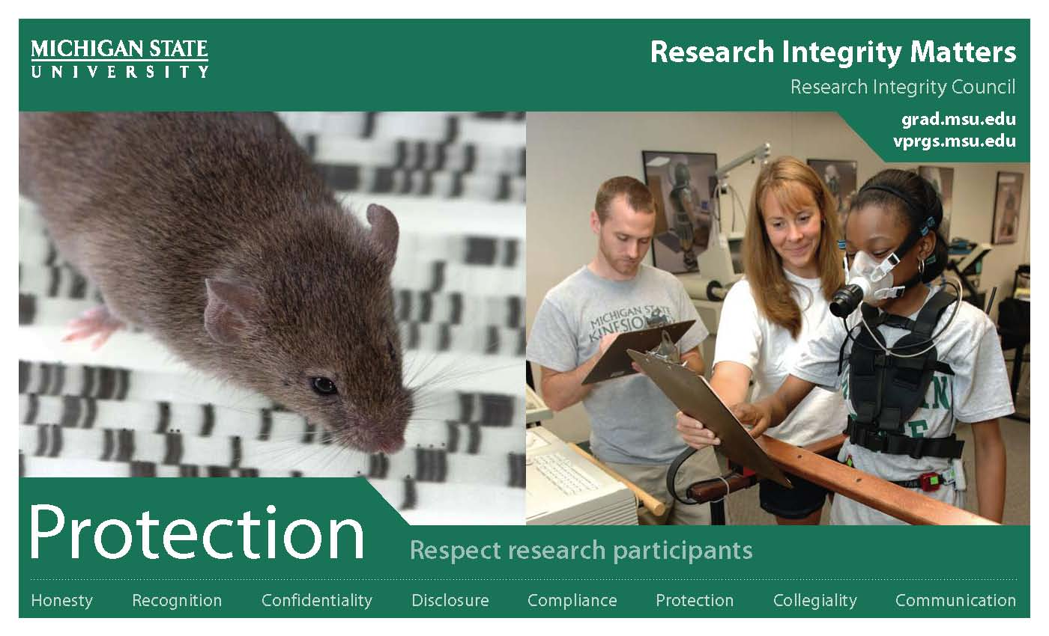
Protections: Respect research participants

Slide 31
Unacceptable Research Practices
“Unacceptable Research Practices” means practices that do not constitute Misconduct but that violate applicable laws, regulations, or other governmental requirements, or University rules or policies, of which the Respondent had received notice or of which the Respondent reasonably should have been aware, for proposing, performing, reviewing, or reporting Research or Creative Activities.

Slide 32

What about individuals who are always on the edge?

Slide 33
Questionable Research Practices
“Questionable Research Practices” means practices that do not constitute Misconduct or Unacceptable Research Practices but that require attention because they could erode confidence in the integrity of Research or Creative Activities.

Slide 34

Collegiality: Work well with others

Slide 35
Question:
What percentage of potential allegations coming to our office is associated with some sort of previous conflict between/among the parties involved?
~ 90%!!

Slide 36
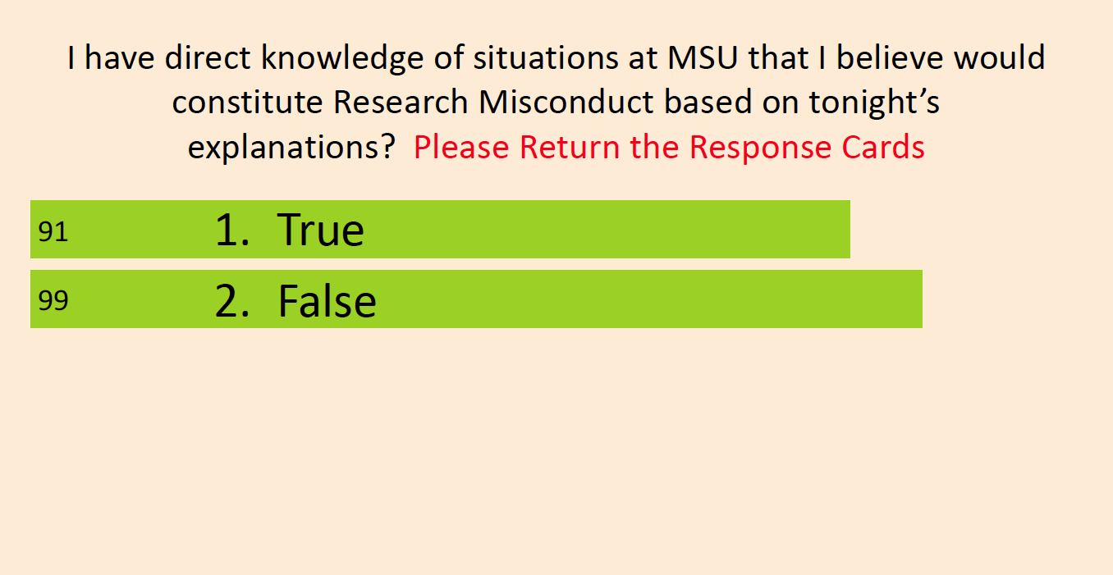
Is Research Misconduct an Issue at MSU?

Slide 37

What about prevention?
Advice
We encourage students, faculty and administrators to ask us about any research issues

Slide 38
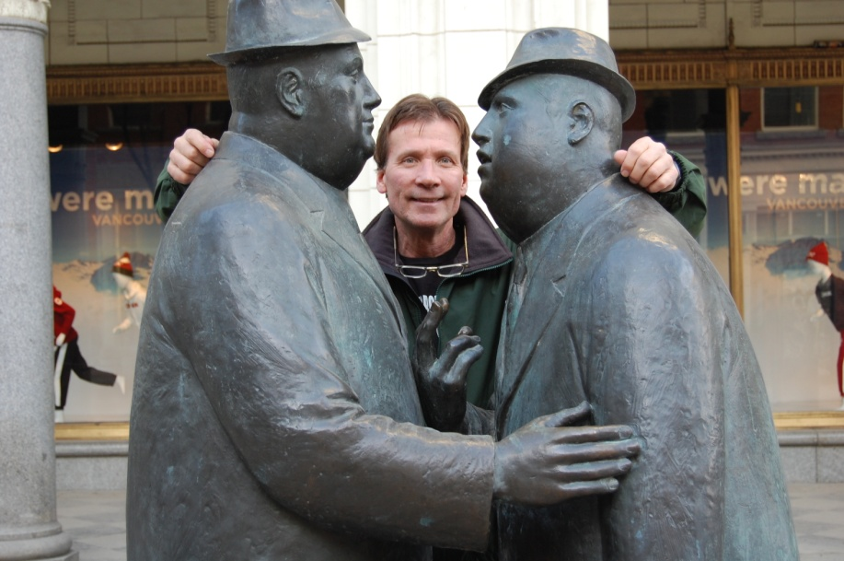
Prevention cont.
Dispute Resolution
We encourage students and faculty to seek our help with settling disputes

Slide 39

Please do one thing for me:

Slide 40
Questions on Research Integrity?
Questions: PollEv.com/msu2019

Slide 41
New Faculty Research Orientation
Grant Resources and Administration
Craig Oneill, Sponsored Programs Manager, Sponsored Programs Administration
Stacy Salisbury, Contract & Grants Manager, Sponsored Programs Administration
Doug Gage, Assistant Vice President for Research and Innovation
Charles Hasemann, Assistant Vice President for Innovation and Economic Development
Terri Miller, Assistant Director for Public Services, MSU Libraries
Questions: PollEv.com/msu2019

Slide 42
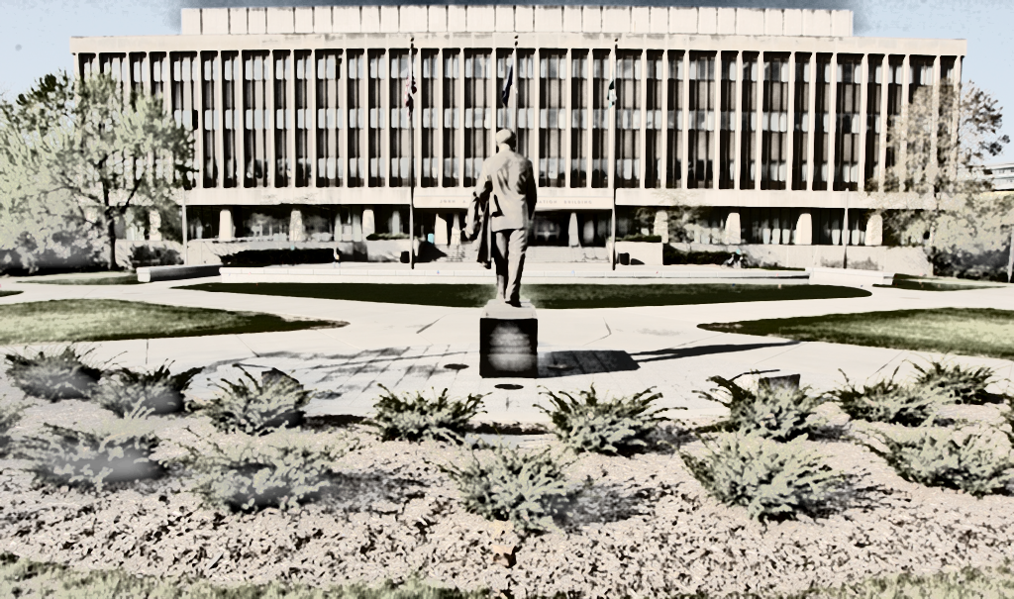
Navigating Extramural Support: Submitting Proposals and Obtaining and Managing Awards
Craig O’Neill, Manager, Office of Sponsored Programs
Stacy Salisbury, Manager, Contract and Grant Administration
Questions: PollEv.com/msu2019

Slide 43
Agenda – SPA/OSP/CGA
Introductions
Topics
Administrative Structure
- Sponsored Programs Administration
- Office of Sponsored Programs
- Contract and Grant Administration
Award Life Cycle Website | Department & College Administrators | How-to Videos
SPA Listserv | Kuali Coeus Enterprise-Level System & CGA Account Explorer | Proposal Tips & Timeline
Award Tips | CGA Account Setup/Modifications | Metrics & Workgroups

Slide 44
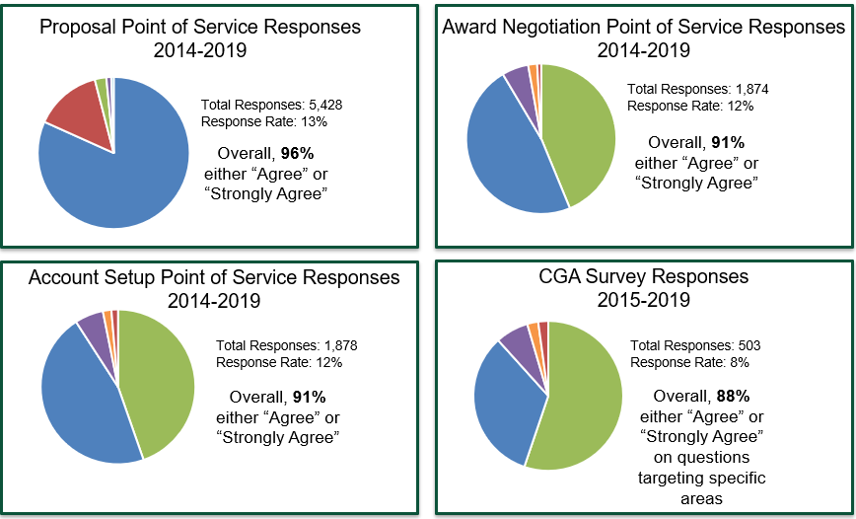
Customer services response rates

Slide 45
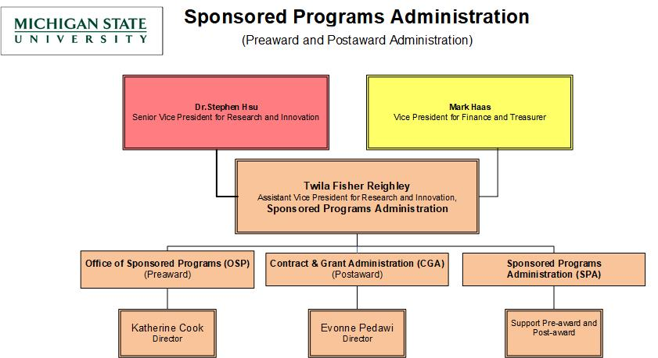
Sponsored Programs

Slide 46
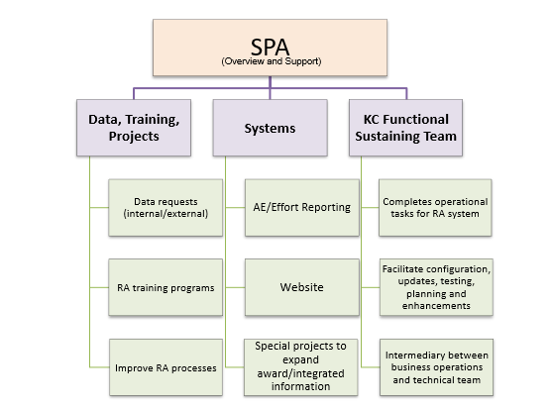
SPA Overview
RA = Research Administration
AE = Account Explorer (system)

Slide 47
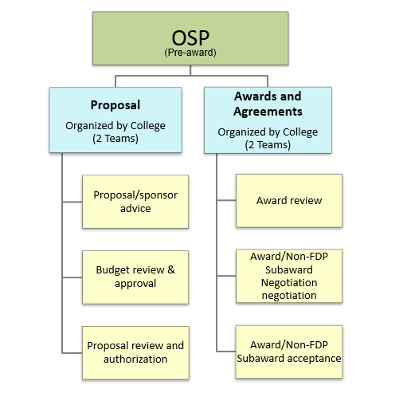
Office of Sponsored Programs (OSP) Overview

Slide 48
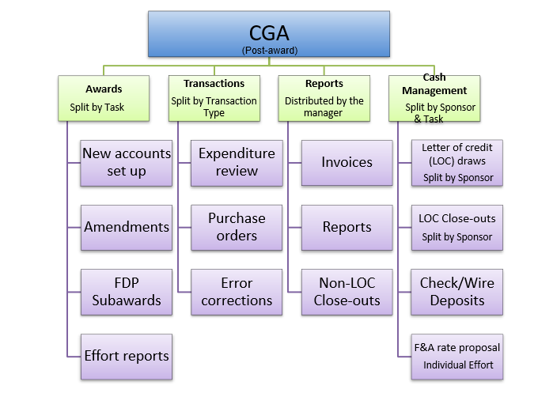
Contract and Grant (CGA) Overview

Slide 49

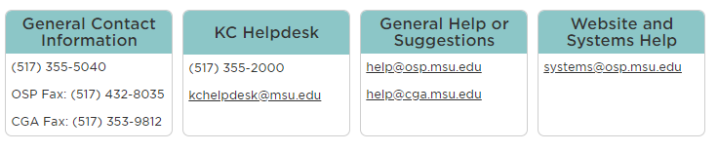

Questions?
Craig O’Neill: oneillc@osp.msu.edu
Stacy Salisbury: dwyers@cga.msu.edu

Slide 50

MSU Innovation Center
Charles Hasemann, Assistant VP for Innovation and Economic Development
Research Orientation, August 22, 2019
Questions: PollEv.com

Slide 51

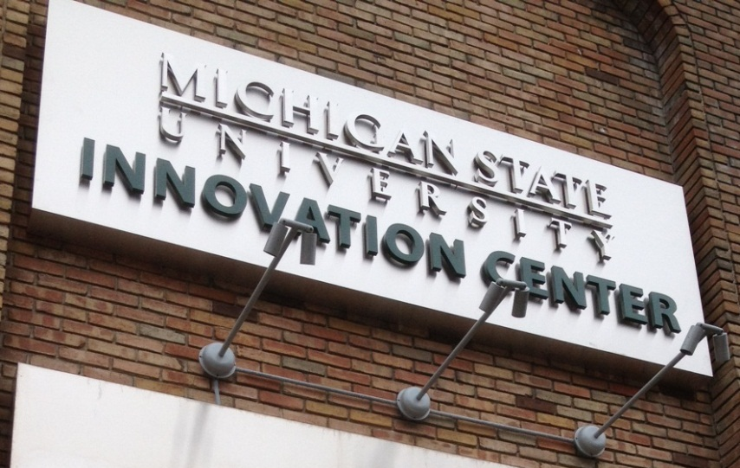

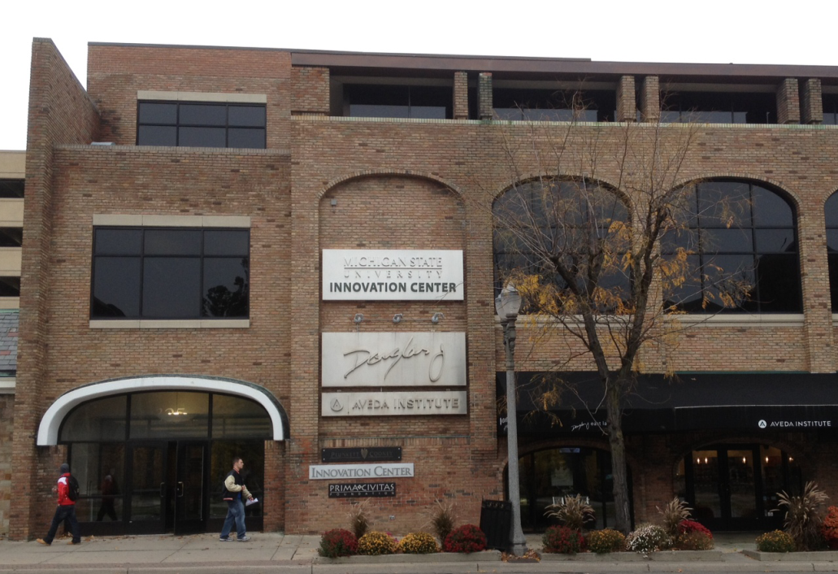

MSU’s place for connecting to the private sector

Slide 52
What we do
Outreach to connect companies to MSU Research strengths.
Company perspectives enrich faculty research
$28M in 2018 corporate-sponsored programs
Taking faculty ideas to the marketplace – seeing research put to practice.
$4.4 million in 2018 royalty revenue
>$1.9M distributed to faculty
Creating companies from MSU-owned ideas.
Professional help to create the best chance for success.
Engaging students in alternative careers.

Slide 53
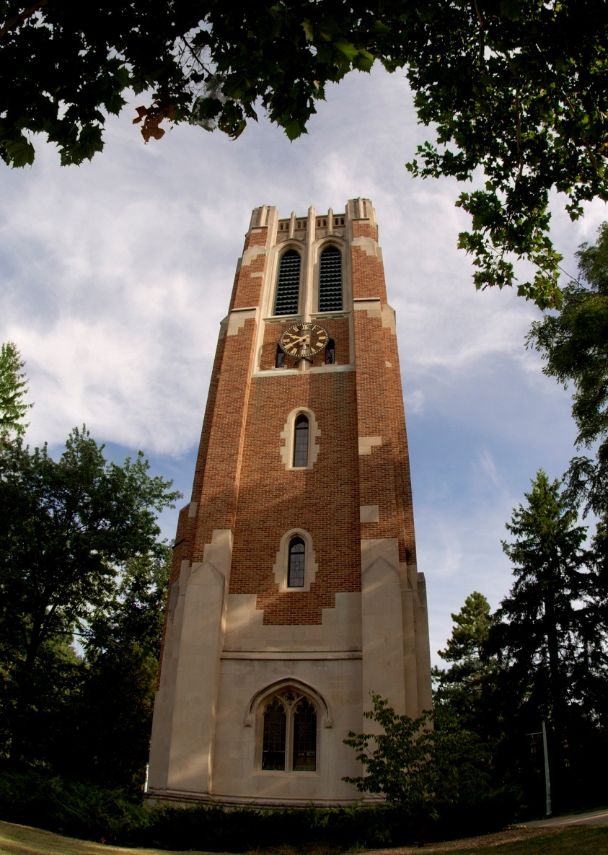
Business-CONNECT:
The Front Door to MSU
Identify MSU Resources: we help companies find researchers & facilities; we navigate the university for them
Build Partnerships: we do proactive business development to build on strategic opportunities – bring us your ideas
One-Stop Shop: We act as an advocate for the deal, translating among stakeholders to find the win-win; we negotiate and sign the agreements

Slide 54
Industry Partners
MSU has a large variety of industry partners – growing every year.

Slide 55
Working with us
How can you work with Business-CONNECT?
Start early. As soon as you are aware of a possibility of partnering with industry, come to Business-CONNECT. Companies may need to move fast; the sooner you get us involved, the better we can match that pace.
Build relationships. MSU wants to build solid bridges to commercial partners. Engage with colleagues in industry when you meet them; treat a sponsored research project as a real partnership; follow through on obligations.
Protect MSU assets. Be aware of how your work can generate new intellectual property. Work with Business-CONNECT and MSU-Technologies by discussing any IP potential of your work.
Again, start early.

Slide 56
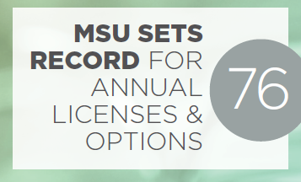

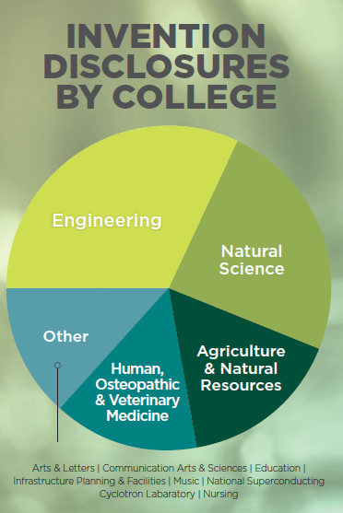

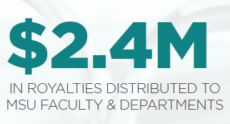
MSUT Commercialization Process
Identify Protect Enhance Capture
Commercialization is achieved by licensing the IP rights to companies who commit to commercialize the technology.

Slide 57

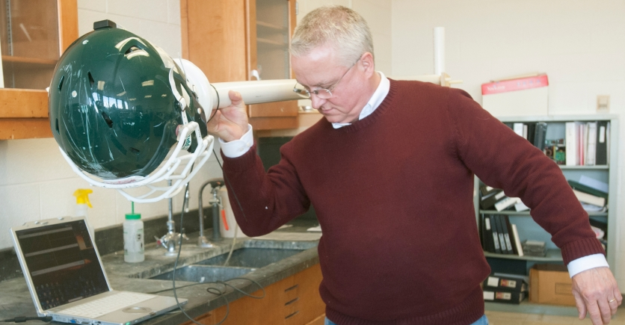

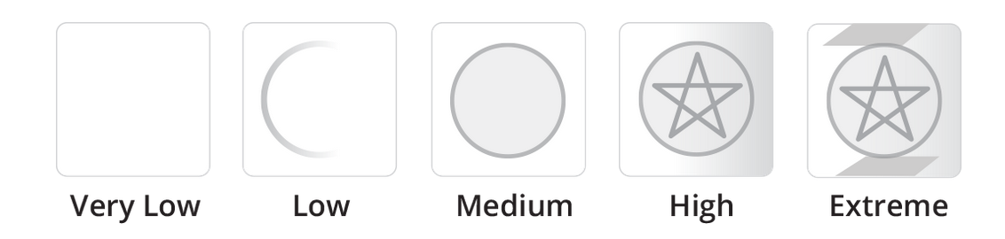


Translational Research
Improve the Technology (gap funding)
prototype development
test in a specific application
test for critical failure modes
Sources
MSU Targeted Support Grant for Tech Development ($50K-$100K)
MSU ADVANCE Proof of Concept Program ($40K matching)
MTRAC: Michigan Translational Research and Commercialization ($25K - $100K)
MSU researchers tackle concussions with new technology

Slide 58













Pipeline of Opportunities
Pipeline of Opportunities
Structured process for startup incubation
Access to dedicated pre-seed venture fund
Over 20 faculty and student startups in past three years
Led by experienced entrepreneurs

Slide 59
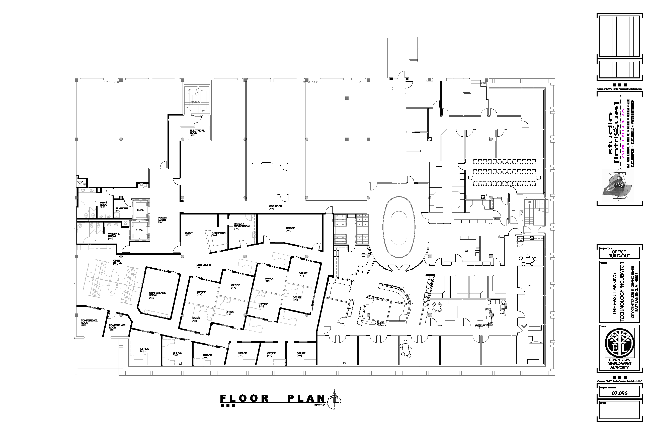





MSU’s place for connecting to the private sector
- come visit any time
Visit us at our
web portal…
http://innovationcenter.msu.edu
325 E. Grand River Ave.
East Lansing, Michigan 48823
517-884-2370
300
Room

Slide 60
Internal Funding Opportunities and Institutionally Limited Proposals
Doug Gage, Assistant VP for Research & Innovation
Research Orientation, August 22, 2019
Questions: PollEv.com

Slide 61

Institutionally Limited Proposals
Limited submission opportunities, including faculty scholar and fellowship programs, available at https://vp.research.msu.edu/ilp
OSVPRI conducts an internal selection process to determine which proposals will be submitted.
  -Where possible, internal deadlines are 8 weeks prior to submission.
Notes:
61

Slide 62
Internal Funding Sources
Competitive, university-wide, peer-reviewed internal grants programs support scholarly activities and provide seed funding for future proposals.
Humanities and Arts Research Program (HARP)
    Scholarship Development proposal (deadline in October)
    Scholarship Production proposals (semiannually)
Strategic Partnership Grant
    Multidisciplinary and/or multi-investigator projects
    Have potential to generate significant external funds
    Proposals solicited in the fall
Discretionary Funding Initiative
    Provides bridge funds for studies needed to resubmit a grant.
Notes:
Scholarship Development for research, creative, and performance projects that help faculty achieve career milestones; deadline in October.
Scholarship Completion, a subvention program for expenses associated with producing the results of a completed research or creative project; proposals accepted quarterly.
Scholarship Development for research, creative, and performance projects that help faculty achieve career milestones; deadline in October.
Scholarship Completion, a subvention program for expenses associated with producing the results of a completed research or creative project; proposals accepted quarterly.
for new projects, bridging grants, and seed funding needed for proposal resubmissions; proposals accepted quarterly.
Refer to the brochure in your folder for a listing of upcoming deadlines.
Many are coming up this fall, but will be very similar for next year so plan ahead.
62

Slide 63
Help Finding Funding
SVP Research & Innovation website lists many external funding sources and internal programs https://vp.research.msu.edu/find-funding
Office of Research Facilitation and Dissemination https://resfacil.msu.edu/ emails funding opportunities directly to colleges and faculty
MSU Libraries offers “Grants and Related Resources” at http://libguides.lib.msu.edu/grants - including the Foundation Center
Other information sources: Office of International Research Collaboration (OIRC), Environmental Science & Policy Program (ESPP)

Slide 64

MSU Libraries: Resources for Researchers
Terri Miller, Asst. Director for Public Services, ticklet@msu.edu

Slide 65
Librarian Liaisons--Partners in Research
Each College has a designated librarian as a liaison
Librarians can help you access not only books and journals, but datasets, media and streaming resources. We strongly encourage that you take advantage of our licensing expertise for online and downloadable resources.
Librarians offer online chat and in-person office hours for students, faculty and staff. Some have office hours in their college.

Slide 66
Libraries Resources
Research Data Management Services to help with data plans required in many research grants
Library Office of Copyright consults on a broad range of copyright issues, from course materials and streaming rights to permissions for large-scale digitization projects
Resources for finding grants includes subscription databases for locating grant information
Reference Librarians provide point-of-need assistance in person, email, and 24/7 chat.

Slide 67
Digital Scholarship @MSULibraries
Digital Scholarship librarians work with researchers on all phases of digital scholarship, from proposal to long-term storage options. We have expertise in text-mining, data visualization, metadata creation, UX, coding and web development.
Extensive series of hands-on workshops held throughout the semester and during breaks on a wide variety of topics: using QGIS, Experimental design, Qualtrics, data storage and retrieval, book design, 3D printing basics

Slide 68
Digital Scholarship Lab @MSU Libraries
Features The 360, a 7m shared visualization room.
Lab space allows advanced faculty and student projects needing specialized software and high capacity computing.
Virtual Reality Lab with Oculus Rift and HTC Vive with dedicated workstation for programming in Unity.
Project Space for digital scholarship teams/projects, including high-performance scanning for documents and media, including 3-D scanning.

Slide 69
Hollander MakeCentral
Includes Publishing Services, which includes coursepack services as well as in-house publishing and a Makerspace
Extensive resources for 3-D printing, including classroom support for integrating design projects
Wide-variety of equipment available for use and checkout, including 360 cameras.

Slide 70
Getting Started at MSU
Panelists
DeAndra Beck, Associate Dean for Research, International Studies and Programs
Deborah Johnson, Professor, Human Development and Family Studies
Merry Morash, Professor, Criminal Justice
Yadu Pokhrel, Assistant Professor, Civil and Environmental Engineering
Ashley Shade, Assistant Professor, Microbiology & Molecular Genetics
Sitara Thobani, Assistant Professor, Residential College in the Arts and Humanities
  Ask questions in person or online at Poll Everywhere
  https://PollEv.com/

Slide 71
Thank you!
We appreciate your time and attendance.
Please be sure to complete the survey in your folder (you can leave on the table).
Best wishes for a successful academic year!

