Slide 1
MSU Research Update February 27, 2019
ACCELERATING THE PACE OF DISCOVERY

Slide 2
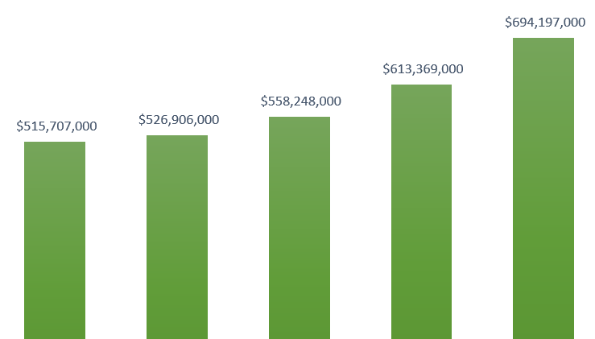
TOTAL MSU RESEARCH EXPENDITURES
Increased from just over $500M to nearly $700M in past five years.
MSU’s NSF HERD ranking is now in the top half of the Big Ten for the first time.
MSU’s overall US rank jumped from 36 to 32 -- growth rate top in B1G.
MSU is now #1 in DOE and combined DOE and NSF expenditures.
2013 2014 2015 2016 2017
Source: NSF HERD Data for 2017

Slide 3
RESEARCH EXPENDITURE RANKINGS
MSU is now ahead of Rutgers, UT Austin, Illinois (UIUC), Purdue, Arizona, Maryland, Indiana, Iowa, ASU, Colorado (Boulder), and UVA.
Almost all of the schools ranked above us (and many below) have major medical research hospitals. In those cases, the medical research number often exceeds that of the rest of campus combined. At MSU, less than ~$100M of our total comes from medical research. We still have significant room to advance.
No medical complex: UC Berkeley $771M (top public university in the US; home of Lawrence Berkeley National Lab) and MIT $952M (home of Lincoln Laboratory, a major defense research lab).
Source: NSF HERD Data for 2017

Slide 4
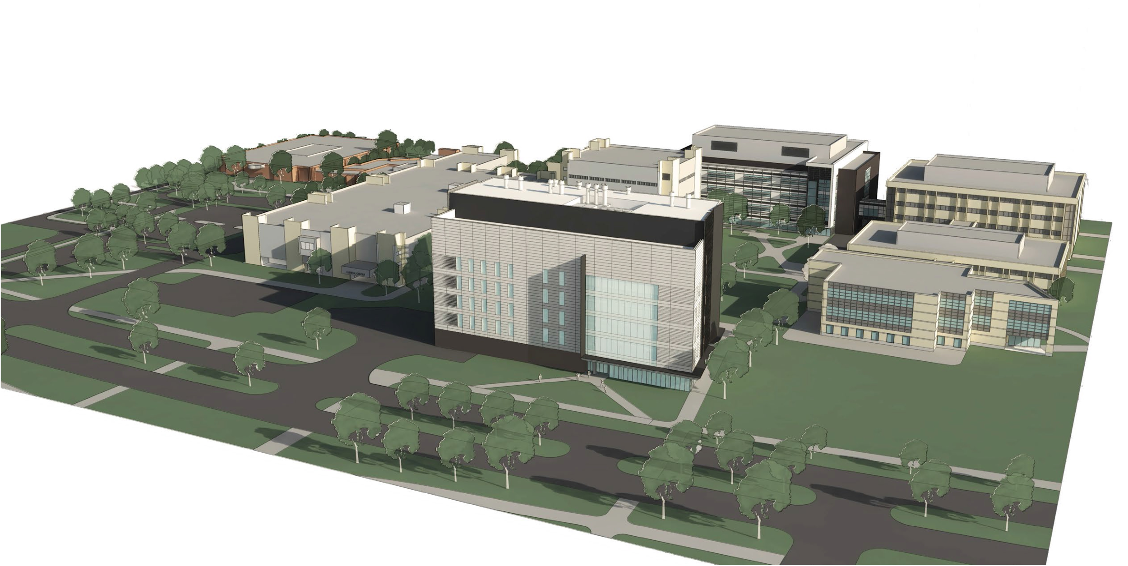
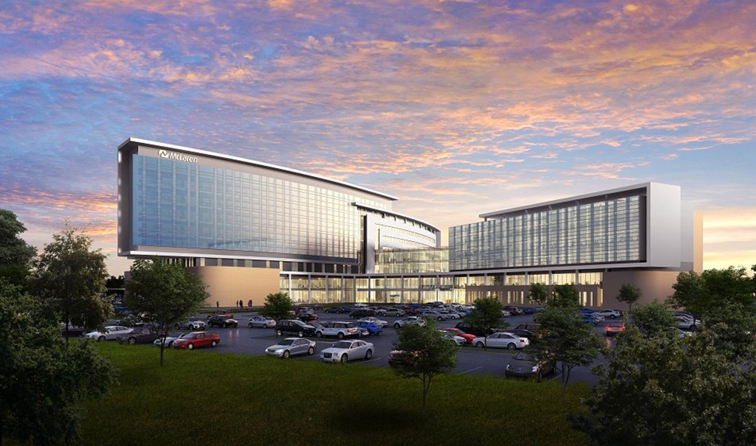
BIOMEDICAL RESEARCH STRATEGY
A biomedical hub has been created with the Institute for Quantitative Health Science and Engineering (IQ) and the new Interdisciplinary Science and Technology building, located near Life Sciences, Nursing and the Clinical Center.
Research collaborations with major health systems, including McLaren, and Spectrum Health in Grand Rapids -- new McLaren Hospital coming in 2021.

Slide 5
TOP PRIORITY: GI2 HIRING STRATEGY SEQUEL
The Global Impact Initiative launched in 2015 with a goal to hire 100 faculty focused on new and enhanced research endeavors.
To date, 86 faculty hired, 27 senior, 59 junior. Recruited from institutions including Stanford, Berkeley, Harvard, MIT, and a number of national labs.
This investment is providing a significant return. In biomedical research, 14 new hires required an investment of $13M in startup funding. Already these individuals have received $30M in new federal funding, which we expect will continue and increase over their careers.
Looking forward to a possible “GI3,” which is the single highest priority for our office.

Slide 6
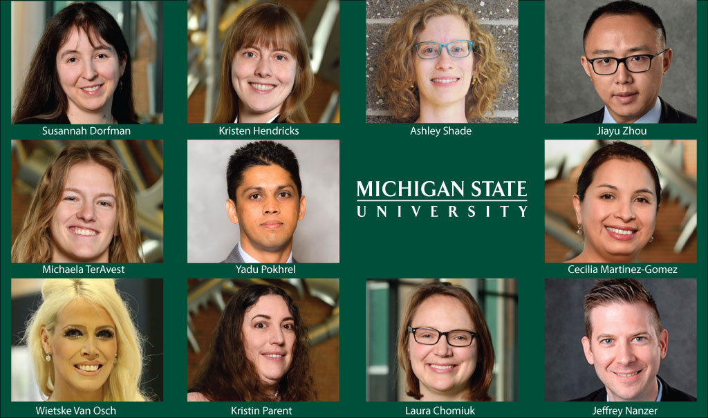
FACULTY POTENTIAL: A SIGN OF OUR FUTURE
Young faculty at MSU have garnered 35 NSF Early CAREER awards since 2013, with 11 in 2018 alone. This indicates strong potential from these young scholars.
Senior faculty have received important corresponding recognitions of excellence, including Guggenheim Fellowships, Mellon Fellowships, and the World Water Prize.
We see a bright future with our strong mix of senior and early career faculty.
Notes:
MSU has already been notified of six recipients for 2019

Slide 7
RESEARCH @ MSU
Questions?
Learn more about us:
Research news website https://research.msu.edu/
VPR unit website https://vp.research.msu.edu/
Spartan Ideas research blog http://spartanideas.msu.edu/
YouTube https://www.youtube.com/msuresearch
Twitter https://twitter.com/msuresearch

